Slide 1

CS6301-MACHINE LEARNING MINI PROJECT ALZHEIMERS DISEASE PREDICTION
GUIDED BY:
Dr .MOHAMED FATHIMAL
ASSISTANT PROFESSOR, DCSE
COLLEGE OF ENGINEERING, GUINDY
TEAM MEMBERS:
DINESH S - 2021103010
HARISH KUMAR KGS - 2021103302

Slide 2
Abstract
Alzheimer's disease (AD) poses a significant challenge in healthcare, necessitating early and accurate diagnosis for effective intervention. This study explores the application of Convolutional Neural Networks (CNN) for the classification of AD based on MRI images. Additionally, this research conducts a comparative analysis by employing traditional machine learning algorithms—Support Vector Machine (SVM), Random Forest, and XGBoost—to underscore the superiority of CNN in handling complex image data.
The methodology involves preprocessing MRI images to enhance features relevant to AD diagnosis. Subsequently, a CNN architecture is developed, comprising multiple convolutional and pooling layers, followed by fully connected layers for classification. The CNN model is trained and validated using a well-curated dataset, emphasizing its ability to discern subtle patterns indicative of AD.
The results underscore the superior performance of the CNN model in accurately classifying AD from MRI images compared to traditional machine learning algorithms. The CNN model exhibits higher accuracy and robustness in handling complex image data, thereby showcasing its potential as a reliable tool for early AD detection.

Slide 3
Introduction
Alzheimer's disease (AD) stands as one of the most pressing challenges in modern healthcare, characterized by progressive cognitive decline and memory loss. Early and accurate diagnosis of AD is pivotal for effective intervention and management. Medical imaging, particularly Magnetic Resonance Imaging (MRI), has emerged as a powerful tool for investigating structural brain changes associated with AD. The utilization of advanced computational techniques, notably Convolutional Neural Networks (CNN), has shown promise in extracting intricate patterns from MRI images for the purpose of AD classification.
This research delves into the realm of employing CNN methodologies for AD prediction through the analysis of MRI images. The primary objective is to leverage the deep learning capabilities of CNN architectures to discern subtle structural alterations in the brain, indicative of AD pathology. By focusing on image-based analysis, this study aims to contribute to the development of robust and accurate diagnostic tools for the early detection of Alzheimer's disease.

Slide 4
Furthermore, to establish a comprehensive understanding of the efficacy of CNN in this domain, this research conducts a comparative analysis. This involves the implementation of traditional machine learning algorithms such as Support Vector Machine (SVM), Random Forest, and XGBoost on the same dataset. The aim is to juxtapose the performance of CNN with these conventional methodologies, shedding light on their respective strengths and limitations in AD prediction based on MRI images.
In summary, this research aims to explore the utilization of CNN-based approaches for AD prediction using MRI images, while also providing a comparative analysis with conventional machine learning techniques. The findings aim to contribute to the ongoing efforts in leveraging advanced computational methods to improve the diagnosis and management of Alzheimer's disease.

Slide 5
PROBLEM DESCRIPTION:
Alzheimer's disease is a debilitating neurodegenerative disorder that primarily affects the elderly population. It is characterized by a gradual decline in cognitive functions, including memory loss, language difficulties, and impaired reasoning. Early detection and prediction of Alzheimer's disease can be vital for ensuring timely medical interventions and support for affected individuals, as there is currently no cure for the disease.
The goal of this problem is to develop a predictive model that can accurately assess the risk of an individual developing Alzheimer's disease based on various factors and biomarkers. This predictive model can be used for early intervention, patient counseling, and research purposes.

Slide 6
OBJECTIVE
By harnessing the potential of machine learning algorithms, we aim to provide a practical tool for early diagnosis and risk assessment, ultimately enhancing the quality of life for individuals affected by AD. Our comprehensive dataset and the diverse range of machine learning techniques employed in this project promise to shed light on the complex interplay of factors contributing to AD, leading to a deeper understanding of the disease's etiology.
Moreover, the robust predictive model developed herein holds the potential to revolutionize healthcare practices by assisting medical professionals in making timely and informed decisions, thus underscoring the invaluable synergy between healthcare and cutting-edge technology

Slide 7
Keygoals:
The key goals of an Alzheimer's disease prediction system are to enhance early detection, patient care, and research related to Alzheimer's disease.
Early Detection: Identify individuals at risk of developing Alzheimer's disease at an early stage, even before noticeable symptoms occur. This early detection can lead to timely interventions and better outcomes for patients.
Risk Assessment: Quantify the likelihood or risk of an individual developing Alzheimer's disease based on various factors, including medical history, genetics, lifestyle, and biomarkers.
Improving Patient Care: Provide healthcare professionals with valuable information to facilitate personalized care and treatment plans for individuals at risk or in the early stages of Alzheimer's disease

Slide 8
Hardware Specifications
• Processor: Intel Core i5 or i7, or AMD Ryzen 5 processors.
• RAM: A minimum of 8GB of RAM
• Storage: 500GB or larger SSD
• GPU : NVIDIA GTX or RTX series with dedicated VRAM

Slide 9
Software Specifications
• Python: Python 3.x
• Machine Learning Libraries: scikit-learn, TensorFlow
• Development Environment: Jupyter Notebook, Visual Studio Code
• Version Control: Git

Slide 10
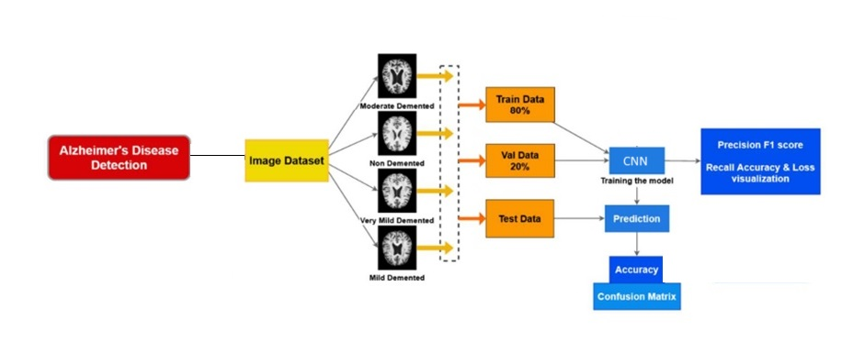
Block Diagram:

Slide 11
Existing Algorithm:
Several machine learning and data analysis algorithms have been used for Alzheimer's disease prediction. Some of the commonly used algorithms for Alzheimer's disease prediction include:
Support Vector Machine (SVM):
SVM is a supervised learning algorithm used for classification tasks. It works by finding the hyperplane that best separates different classes in the feature space, maximizing the margin between them.
Application in AD Prediction: SVM has been employed in AD prediction by using extracted features from MRI images to classify between healthy individuals and those with AD.
Limitations: SVM's performance might plateau with complex and high-dimensional data like MRI images, as it heavily relies on feature engineering and might struggle to capture intricate patterns within the data.

Slide 12
Random Forest Classifier:
Brief Explanation: Random Forest is an ensemble learning method that constructs multiple decision trees during training and merges their outputs to improve accuracy and prevent overfitting.
Application in AD Prediction: Random Forest has been used in AD prediction by leveraging the features extracted from MRI images to build an ensemble of decision trees for classification purposes.
Limitations: While Random Forest can handle high-dimensional data and mitigate overfitting, it might face challenges in capturing the intricate spatial relationships within MRI images due to its reliance on decision trees.

Slide 13
How CNN Addresses Their Issues:
Feature Learning: CNNs excel in automatically learning hierarchical representations and features directly from raw data (in this case, MRI images). They can discern intricate spatial patterns without the need for explicit feature engineering.
Handling High-Dimensional Data: CNNs are adept at handling high-dimensional and complex data like MRI images by using convolutional layers to extract spatial hierarchies and relevant features.
Capturing Spatial Relationships: CNN architectures, with their convolutional layers and pooling operations, can capture spatial dependencies and nuanced patterns present in MRI images, potentially outperforming traditional algorithms in understanding complex image structures.

Slide 14
Proposed Algorithm:
Utilizing a proposed algorithm, we employ Convolutional Neural Networks (CNNs) to predict Alzheimer's disease through the analysis of brain images, including MRI scans. This comprehensive approach involves data collection, preprocessing, the design of a specialized CNN architecture, model training, rigorous evaluation, and the interpretation of key features in brain images. With a strong emphasis on ethical considerations, this innovative algorithm has the potential to aid in early Alzheimer's disease diagnosis and ongoing improvements in patient care. We also proposed using traditional better algorithms like KNN, XGBOOST etc.

Slide 15
Proposed project summary
Objective: The primary aim of this project is to develop an accurate and efficient Alzheimer's disease prediction system by leveraging advanced machine learning models. Specifically, the focus will be on utilizing Convolutional Neural Networks (CNN), k-Nearest Neighbours (K-NN), and XGBoost algorithms to enhance the accuracy of classification and provide robust predictions based on MRI images.
Convolutional Neural Network (CNN):
Objective: The CNN model will be the primary focus due to its capability to extract intricate spatial features from MRI images, crucial for identifying patterns indicative of Alzheimer's disease.
Key Features:
CNN architectures will be designed to automatically learn and discern intricate structural alterations within MRI images associated with AD pathology.
Ability to capture complex spatial relationships in brain imaging data, allowing for improved detection of subtle changes indicative of Alzheimer's disease progression.

Slide 16
k-Nearest Neighbours (K-NN):
Objective: K-NN will complement the CNN by utilizing extracted features and comparing similarities among data points to classify MRI images into AD or non-AD categories.
Key Features:
Utilizes a proximity-based approach to classify new instances by comparing them with labeled instances in the training dataset.
Provides a simple yet effective method for classification based on feature similarity.
XGBoost:
Objective: XGBoost, an ensemble learning technique, will be employed to enhance the classification performance by combining multiple weak learners into a robust model.
Key Features:
Capable of handling high-dimensional data and capturing complex relationships within the feature space.
Utilizes boosting to sequentially improve upon previous models, potentially enhancing prediction accuracy for Alzheimer's disease classification.

Slide 17
User Interface:
The user interface is developed using stream lit, offering an engaging and intuitive platform for users to interact by uploading their brain MRI images.
Image File Upload:
Users can seamlessly upload MRI image files for real-time disease prediction.
Interactive Output:
- Predictions are represented through an confidence map, displaying the probabilities of the image belonging to different classes.
User Engagement:
- The stream lit interface ensures a user-friendly experience, making MRI prediction accessible to a broad range of users.

Slide 18
Technology stack
- Language Used: Python
- Machine Learning Libraries: TensorFlow, Keras, Scikit-learn
- User Interface: streamlit
- Data Manipulation: Pandas, NumPy
- Visualization: Matplotlib

Slide 19
Project Framework
Data Preprocessing: MRI images will undergo preprocessing steps to extract relevant features and enhance their quality for model input.
Model Training and Validation: The CNN, K-NN, and XGBoost models will be trained and validated using labeled MRI datasets, ensuring their ability to accurately classify between AD and non-AD cases.
Comparative Analysis: The performance of the three models will be compared based on various metrics such as accuracy, precision, recall, and F1-score to identify the most effective approach for Alzheimer's disease prediction.
Development of Prediction System: A user-friendly interface will be developed to enable real-time predictions using the most effective model, facilitating intuitive use by clinicians or healthcare professionals.

Slide 20
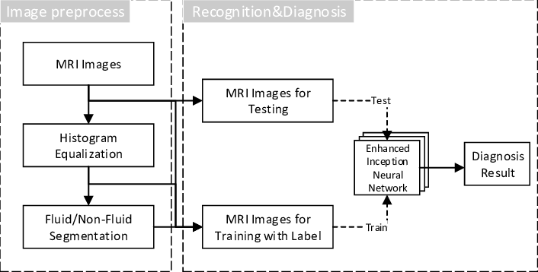
Architecture diagram

Slide 21
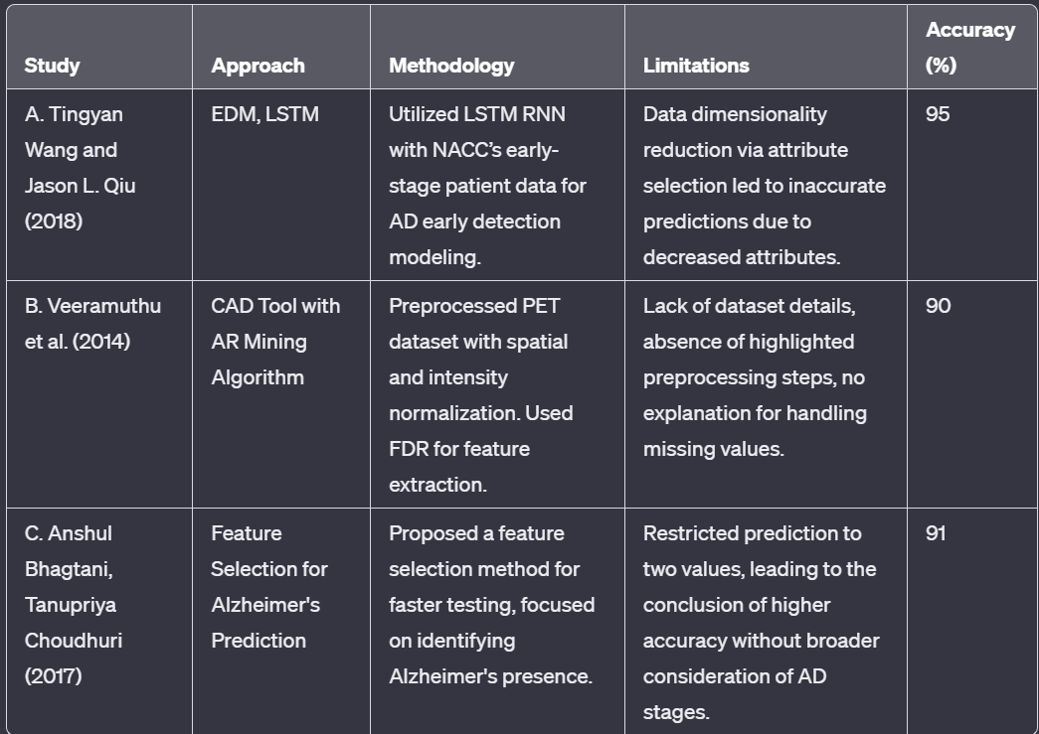
Literature review

Slide 22
Technical modules:
1.User Interface Design
1.1.Upload image
1.2.Get Predicted Output
2.Training
2.1.Models Used-Convolutional Neural Networks (CNN), K-Nearest Neighbors (KNN), Support Vector
machine(SVM), XGboost, Random Forest Classifier
2.1.1.Feature Extraction
2.1.2.Train and Test Data Split
2.1.3.Fitting the Model
3.Testing
3.1.Predict using test dataset
3.2.Calculate Accuracy
3.3.Calculate F1-Score
3.4.Display Confusion Matrix

Slide 23
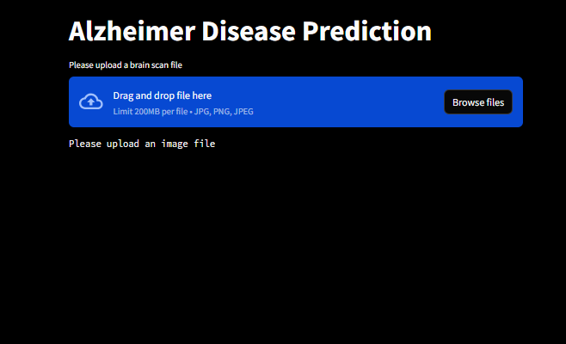
Technical Modules
User Interface Design
Input:
The user interacts with the system by providing an image file in standard formats such as jpg ,jpeg or png . This file serves as the input to the Alzheimer’s disease prediction system.

Slide 24
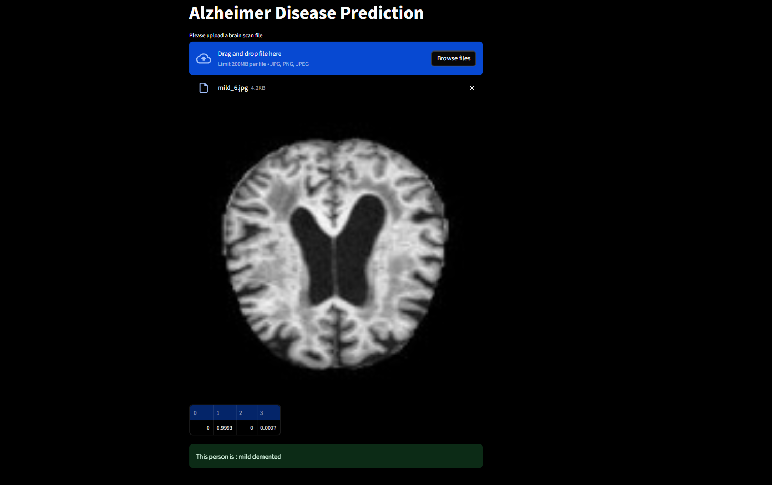
Output:

Slide 25
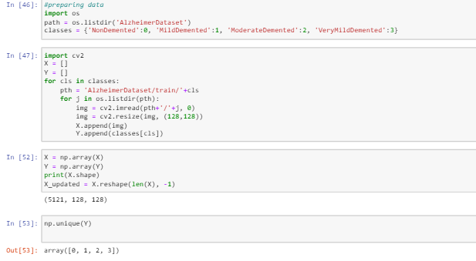
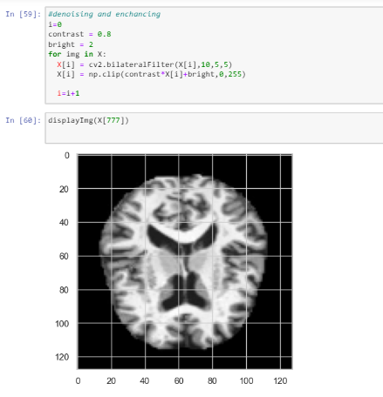
Data preprocessing

Slide 26
Algorithms used
Module 1 – SVM
Module 2 - RANDOM FOREST CLASSIFIER
Module 3 - KNN
Module 4 - XGBOOST
Module 5 - CNN

Slide 27
Support Vector Machine (SVM):
Usage: SVM is a supervised learning algorithm used for classification and regression analysis.
Operation: It finds the optimal hyperplane that best separates data points in a high-dimensional space, maximizing the margin between classes.
Strengths: Effective in high-dimensional spaces, versatile due to various kernel functions, and less prone to overfitting.
Random Forest:
Usage: Random Forest is an ensemble learning method used for classification, regression, and anomaly detection.
Operation: It builds multiple decision trees during training and merges their outputs to improve accuracy and reduce variance.
Strengths: Resistant to overfitting, handles large datasets well, provides feature importance, and is suitable for complex data.

Slide 28
k-Nearest Neighbors (K-NN):
Usage: K-NN is a simple yet effective supervised learning algorithm used for classification and regression.
Operation: It classifies instances based on the majority class among their k-nearest neighbors in the training set.
Strengths: Intuitive, easy to implement, non-parametric, and adapts well to different types of data.
XGBoost (Extreme Gradient Boosting):
Usage: XGBoost is a powerful boosting algorithm used for regression, classification, and ranking tasks.
Operation: It's an ensemble of weak decision trees that sequentially correct errors of preceding models.
Strengths: High performance, handles missing data, minimizes overfitting, and supports regularization techniques.

Slide 29
Convolutional Neural Network (CNN):
Usage: CNN is a deep learning architecture primarily used for image analysis, including image classification and object recognition.
Operation: Employs convolutional layers to extract hierarchical features from images, learning spatial relationships.
Strengths: Excellent for image data, learns spatial hierarchies, reduces manual feature engineering, and performs well on large datasets.

Slide 30
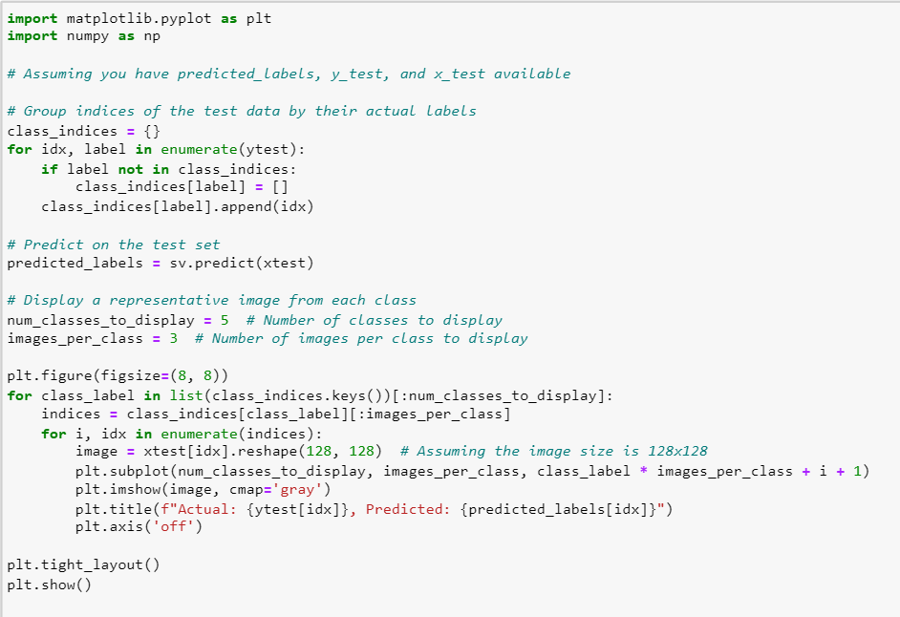
Code snippets - svm

Slide 31
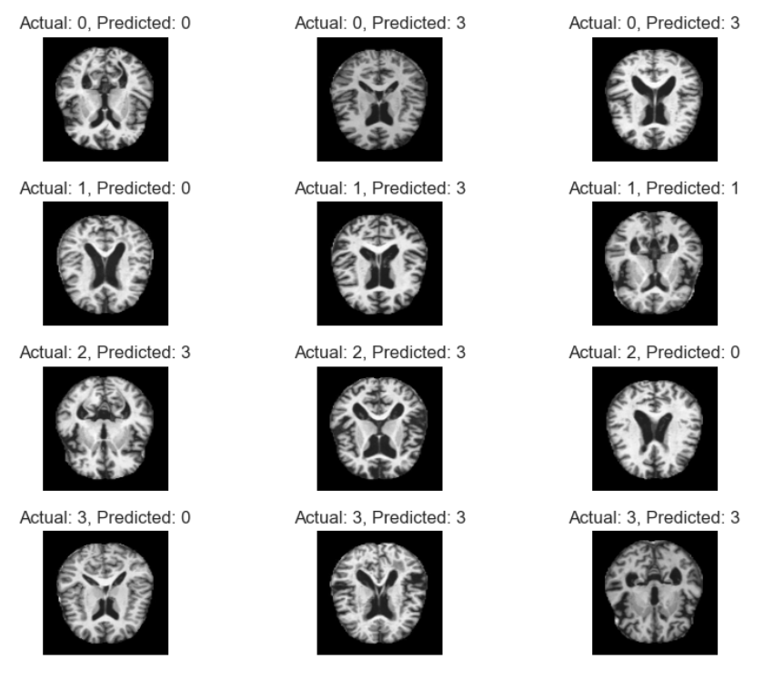
SVM – prediction and actual output

Slide 32
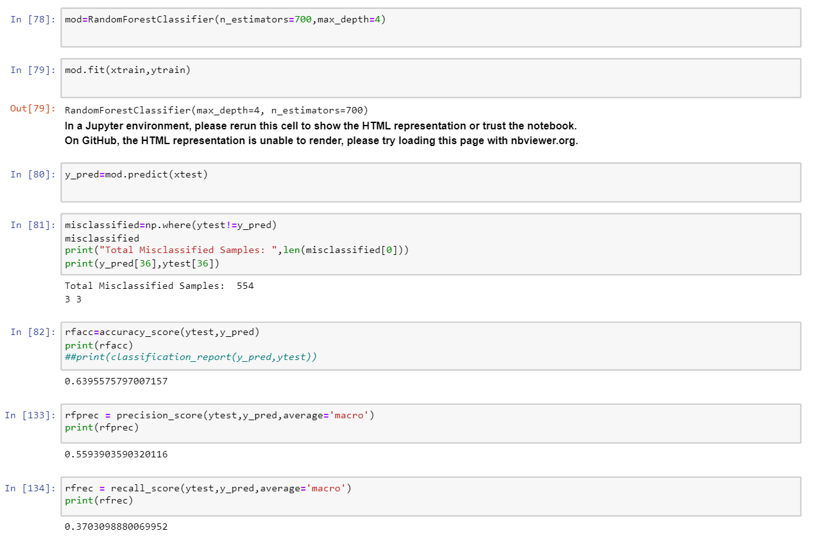
Random forest classifier

Slide 33

RANDOM FOREst classifier-prediction and actual o/p

Slide 34
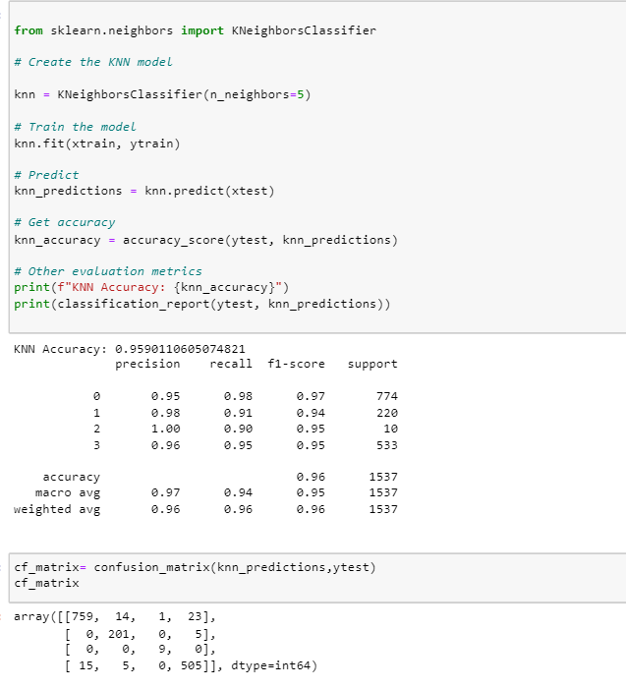
knn

Slide 35
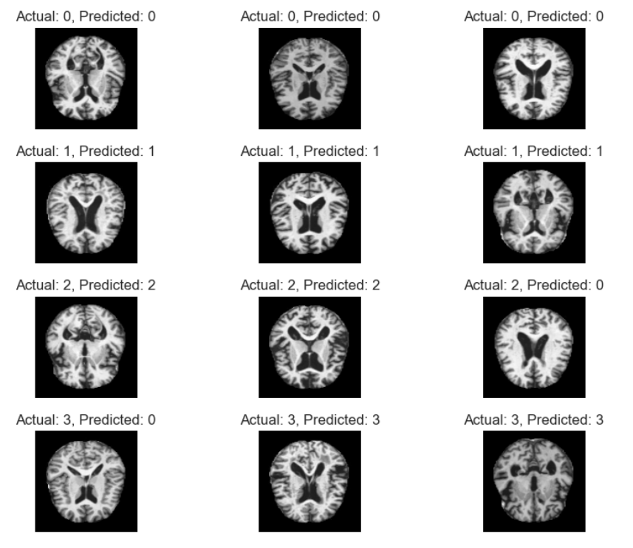
KNN-prediction and actual output

Slide 36
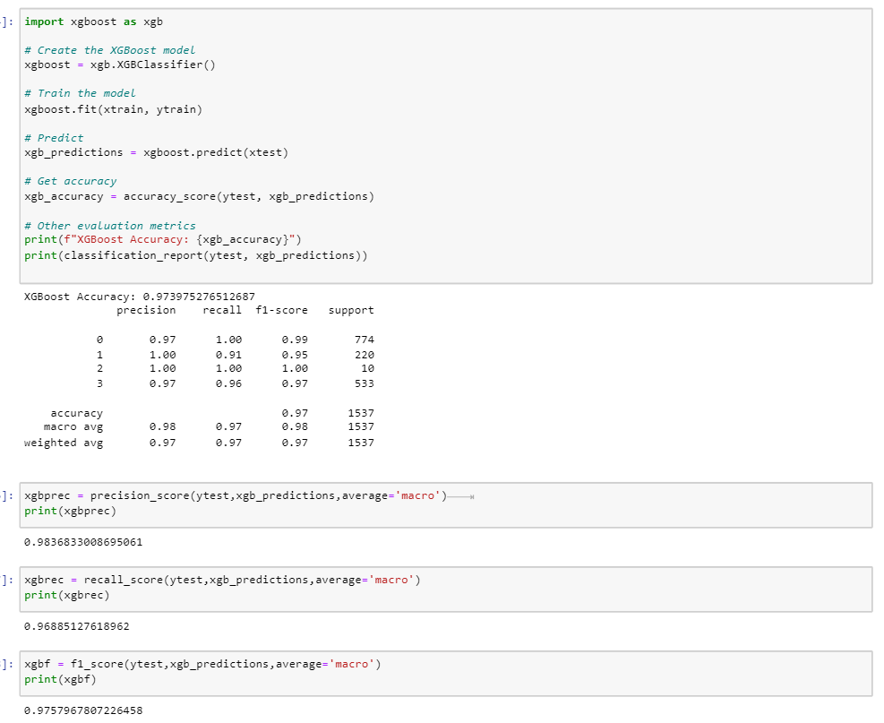
Xgboost

Slide 37
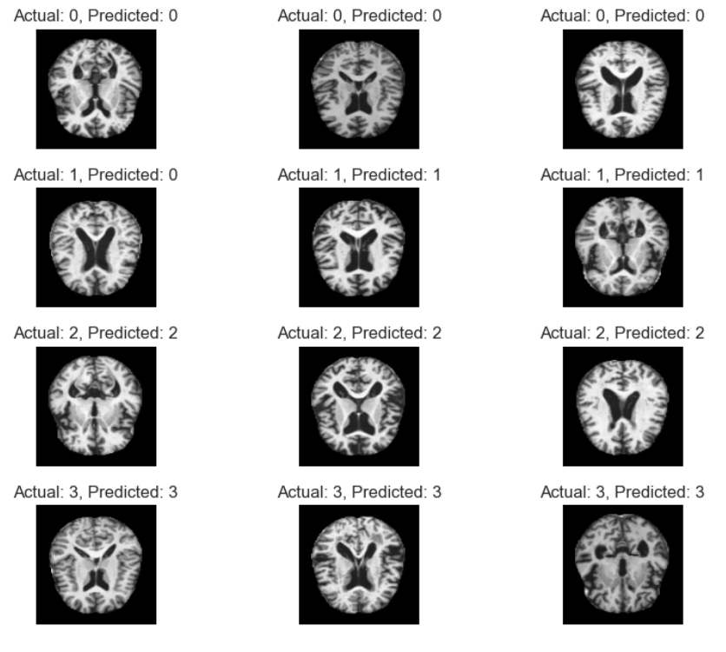
XGboost - prediction and actual output

Slide 38
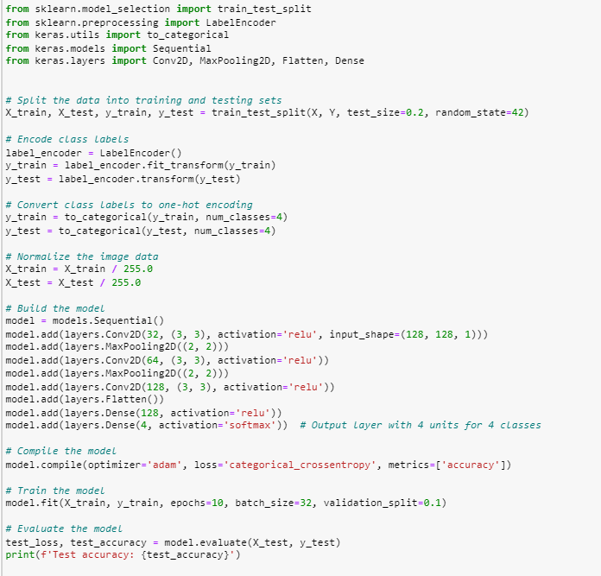
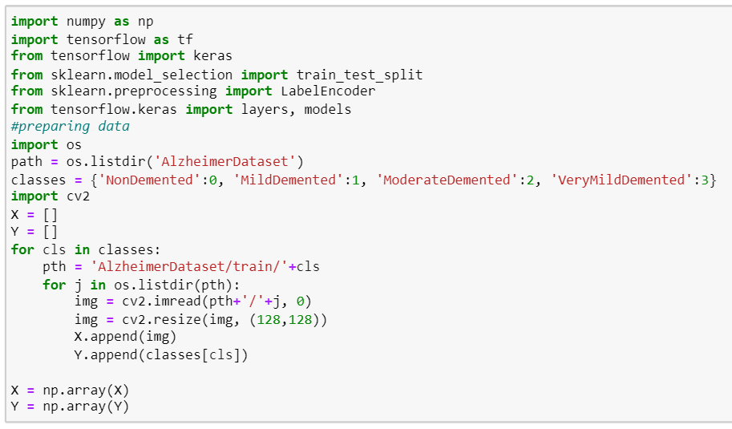
cnn

Slide 39
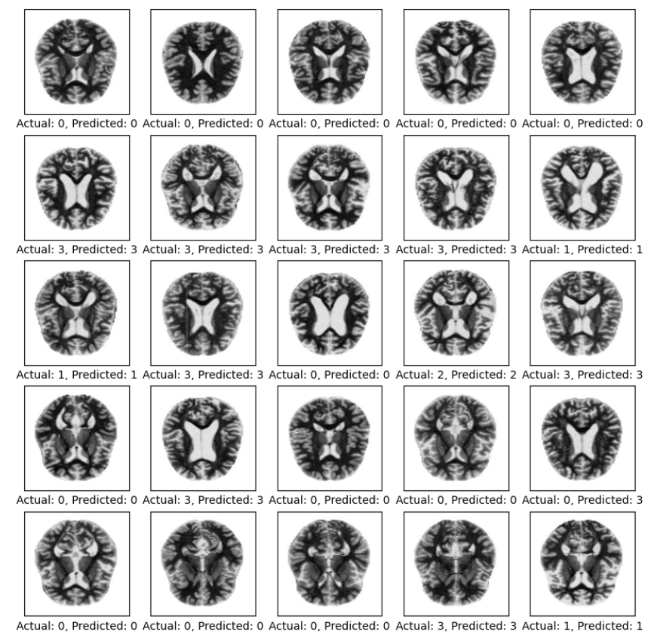
CNN – Prediction and actual output

Slide 40
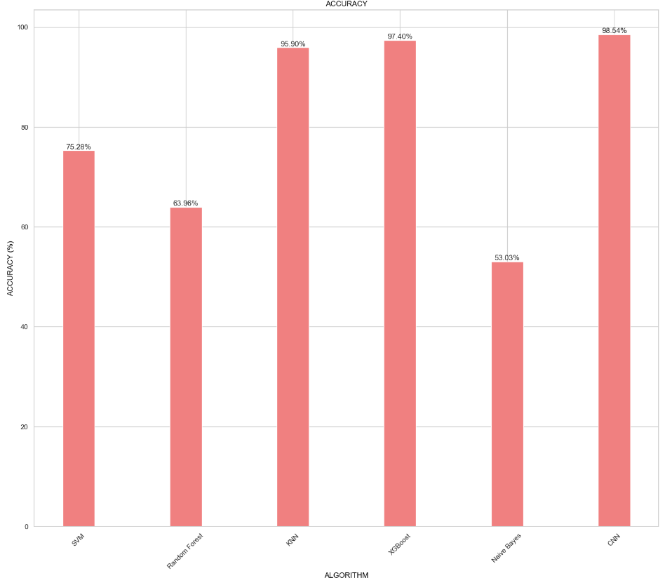

Slide 41
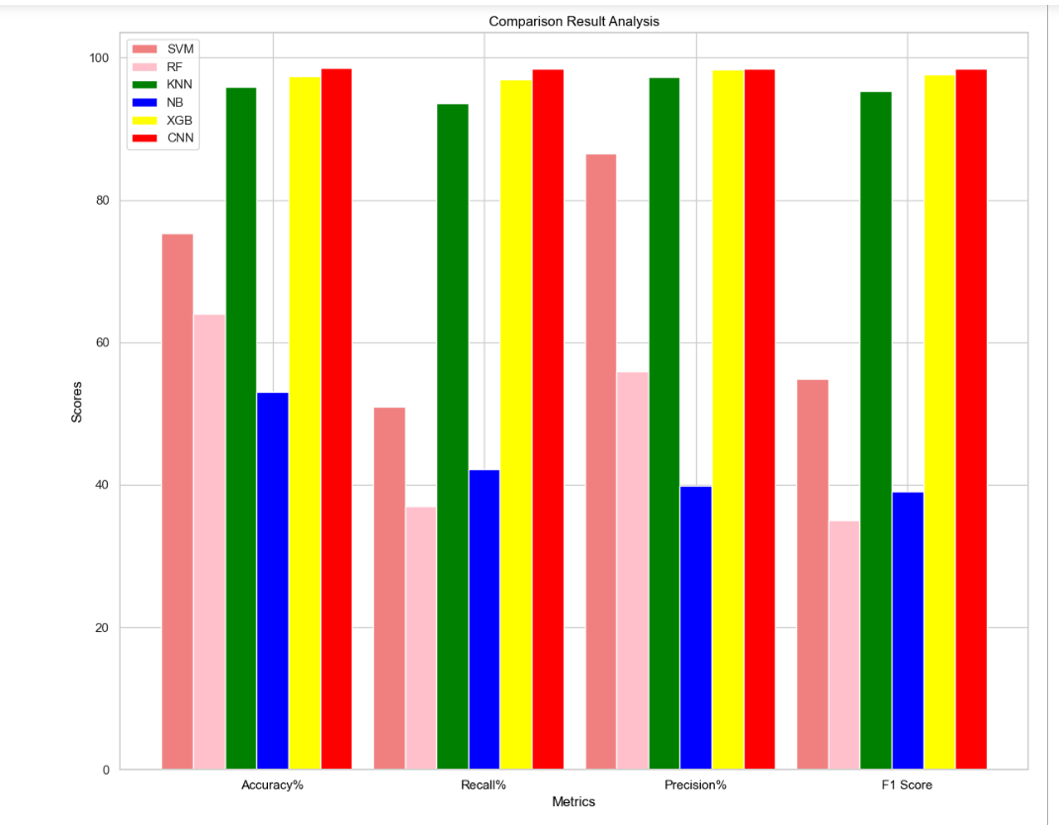

Slide 42
Dataset Description
Prediction of Alzheimer’s disease is made using the dataset containing the MRI scans of various individuals. The dataset was acquired from the Kaggle open-source environment. It contains the MRI brain scans of people affected by Alzheimer’s disease and not affected ones(all 4 stages: ND,VMD,MD,D) . The dataset is split into 2 parts for training and testing. This dataset is a valuable resource for our project due to its comprehensive nature and potential to provide critical insights into the diagnosis of Alzheimer's Disease (AD).
Link to dataset - https://www.kaggle.com/code/gauravan/alzheimer-s-model-building/notebook

Slide 43
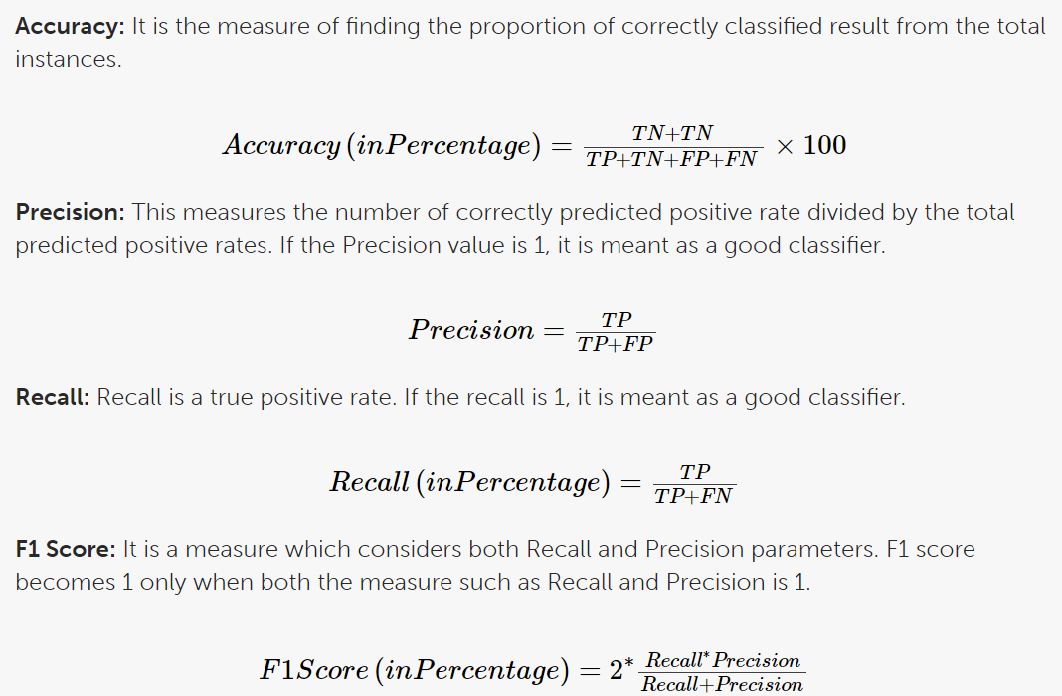
Performance Metrics
The most common metrics are the conversions of the True Positive (TP), the False Positive (FP), the True Negative (TN), and the False Negative (FN) metrics.

Slide 44
REFERENCES
Aamir M, Nawi NM, Mahdin HB, Naseem R, Zulqarnain M (2020) Auto-encoder variants for solving
handwritten digits classification problem. Int J Fuzzy Logic Intell Syst 20(1):8–16
Activation function neural network (2020) https://www.geeksforgeeks.org/activation-functions-neuralnetworks/
Aderghal K, Khvostikov A, Krylov A, Benois-Pineau J, Afdel K, Catheline G (2018) Classification of
Alzheimer disease on imaging modalities with Deep CNNs using cross-modal transfer Learning. 2018
IEEE 31st international symposium on computer-Based medical systems (CBMS).
Advantages and disadvantages of functional MRI (2019) https://www.ed.ac.uk/clinical-sciences/
edinburgh-imaging/research/themes-and-topics/medical-physics/imaging-techniques/functional-mri
https://chat.openai.com/

Slide 45
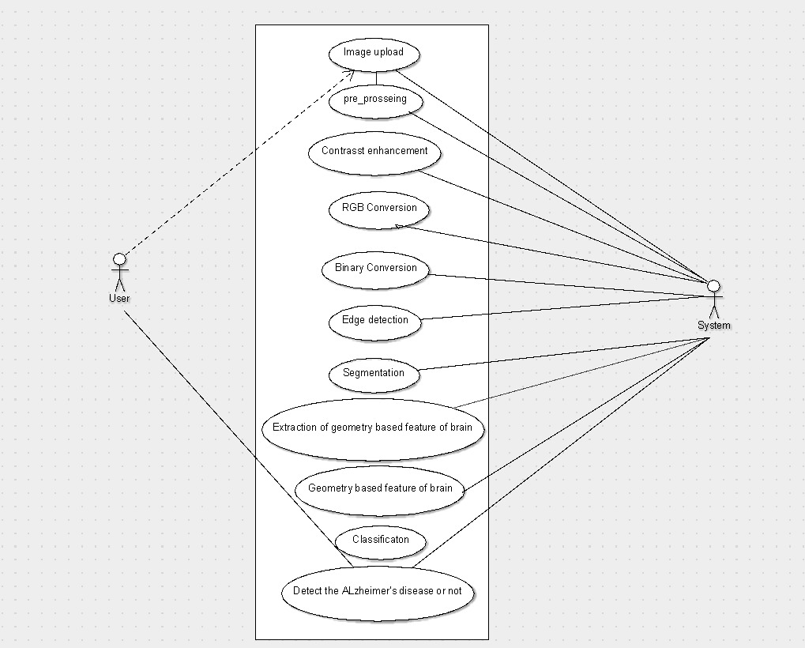
USE CASE DIAGRAM

Slide 46
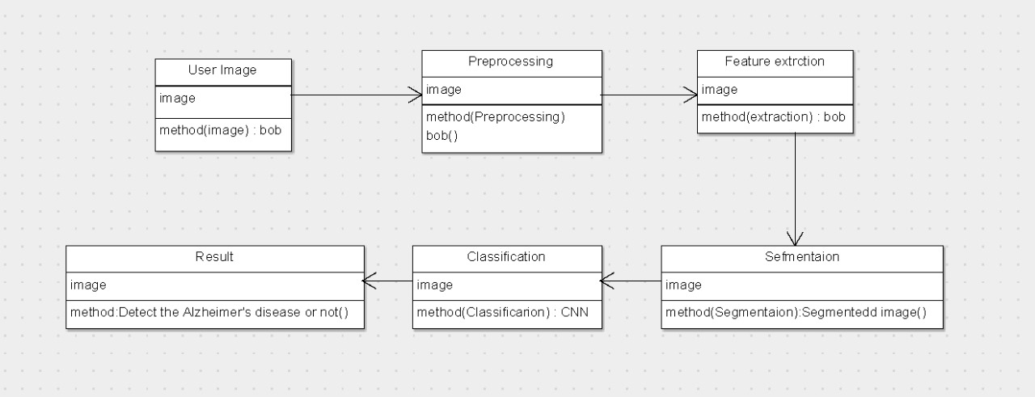
CLASS DIAGRAM

Slide 47
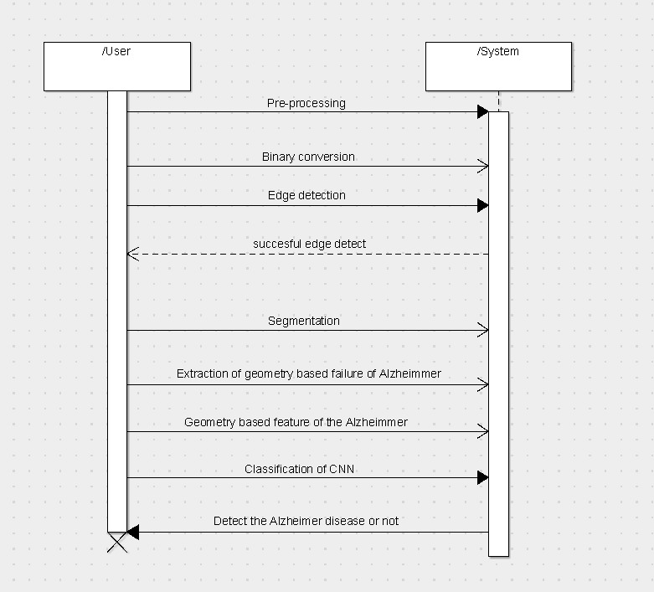
SEQUENCE DIAGRAM

Slide 48
CONCLUSION
Key Findings:
Convolutional Neural Networks (CNN) showcased superior potential in accurately classifying Alzheimer's disease based on MRI imaging data.
Comparative analysis highlighted CNN's adeptness in discerning intricate structural patterns indicative of AD pathology.
Implications:
CNN-based approaches offer promising avenues for precise and timely Alzheimer's disease detection, enabling proactive intervention strategies.
Understanding algorithmic strengths and limitations provides insights for improved AD prediction methodologies.

Slide 49
Future Focus:
Exploration of ensemble methods and fusion techniques to enhance prediction accuracy and clinical applicability.
Addressing challenges like imbalanced datasets and interpretability for further model refinement.
Impact:
Signifies progress in leveraging advanced ML techniques, especially CNN, for efficient Alzheimer's disease prediction.
Potential influence on healthcare practices, fostering early diagnosis and improved patient care in AD management.

